Slide 1
Heterogeneous Graphs

Slide 2
Overview
Introduction to heterogeneous graphs
Extending GCNs for heterogeneous graphs
Inferences on relational graphs

Slide 3
Heterogeneous graph introduction

Slide 4
Heterogeneous vs. homogeneous graphs
To date, we have only considered homogeneous graphs
Homogeneous graphs– all nodes and edges are of the same type and have the same attributes
Heterogeneous graph– different node and/or edge types with possibly different attributes.

Slide 5
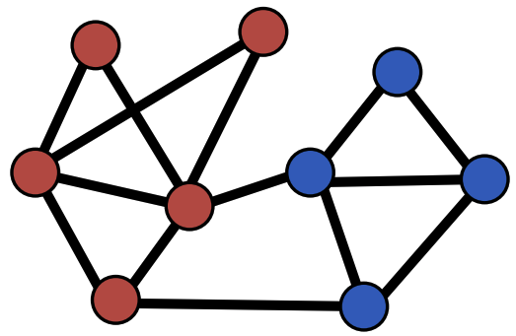
Heterogenous graphs example
Citation network with 2 types of nodes:
Node type A: paper nodes
Node type B: author nodes
Image credit: Jure Leskovec, http://cs224w.stanford.edu

Slide 6
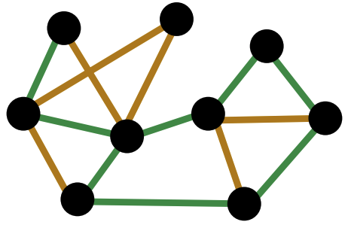
Heterogenous graphs example
Citation network with 2 types of edges:
Edge type A: cites
Node type B: likes
Image credit: Jure Leskovec, http://cs224w.stanford.edu

Slide 7
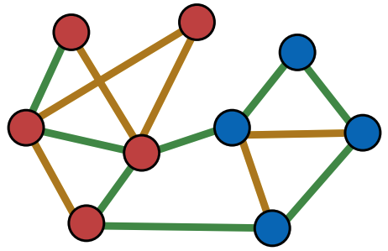
Heterogenous graphs example
Overall graph has 2 node and 2 edge types
8 possible relation types in this graph where the relation type is defined by the triple: (node_start type, edge type, node_end type)
(paper, cites, paper)
(paper, likes, paper)
(paper, cites, author)
(paper, likes, author)
(author, cites, author)
(author, likes, author)
(author, cites, paper)
(author, likes, author)
Image credit: Jure Leskovec, http://cs224w.stanford.edu

Slide 8
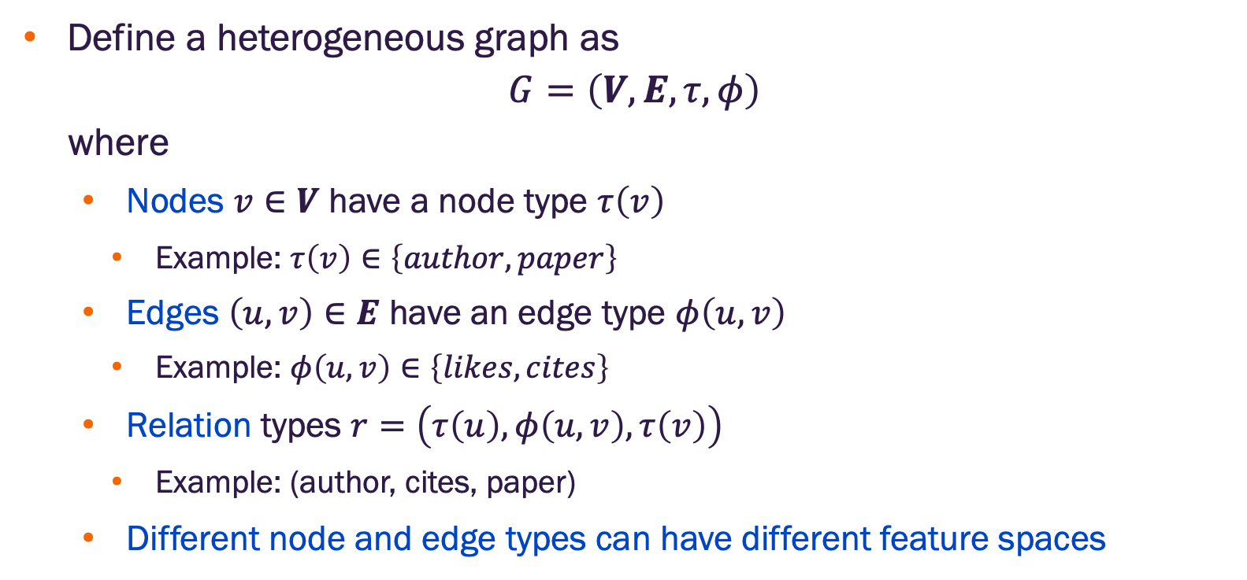
Heterogeneous graphs terminology
Define a heterogeneous graph as
$$G=\left(V, E,τ,φ\right)$$
where
Nodes $v∈V$ have a node type $τ\left(v\right)$
Example: $τ\left(v\right)∈\left\{author, paper\right\}$
Edges $\left(u,v\right)∈E$ have an edge type $φ\left(u,v\right)$
Example: $φ\left(u,v\right)∈\left\{likes, cites\right\}$
Relation types $r=\left(τ\left(u\right),φ\left(u,v\right),τ\left(v\right)\right)$
Example: (author, cites, paper)
Different node and edge types can have different feature spaces

Slide 9
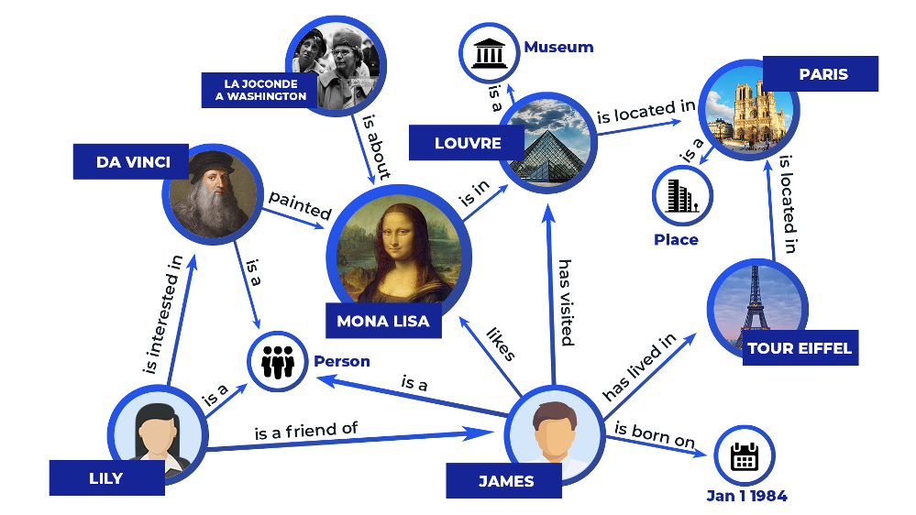
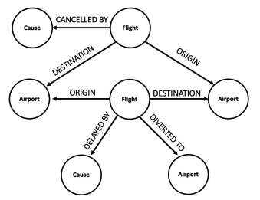
Many graphs are heterogeneous
Image credit: Zilliz
Image credit: Jure Leskovec, http://cs224w.stanford.edu
Knowledge Graphs
Node types: Artifact, Museum, Person, Place
Edge types: is_a, is_a_friend_of, is_born_on
Example Relation: Lilly, is_friend_of, James
Event Graphs
Node types: Airport, Cause, Flight
Edge types: Origin, Delayed By, Cancelled By
Example Relation: Flight, Delayed BY, Cause

Slide 10
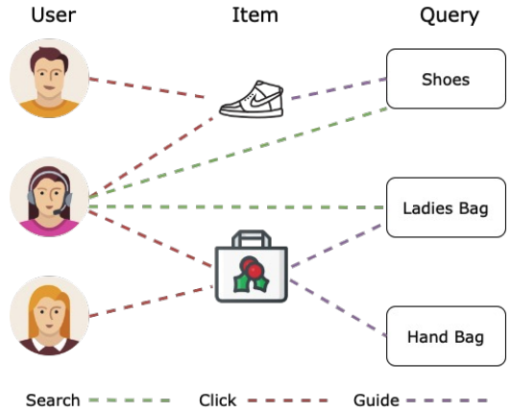
Many graphs are heterogeneous
E-commerce graph
Node types: User, Item, Query, …
Edge types: Purchase, Visit, Guide, Search, …
Different node types have different feature spaces
Image credit: Jure Leskovec, http://cs224w.stanford.edu

Slide 11
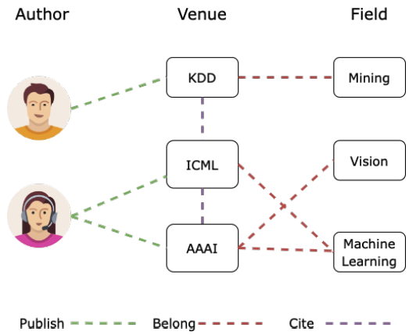
Many graphs are heterogeneous
Microsoft Open Academic Graph
Node types: Author, Paper, Venue, Field, …
Edge types: Publish, Cite, Belong, …
>300M papers, >64M edges
https://www.microsoft.com/en-us/research/project/open-academic-graph/
Image credit: Jure Leskovec, http://cs224w.stanford.edu

Slide 12
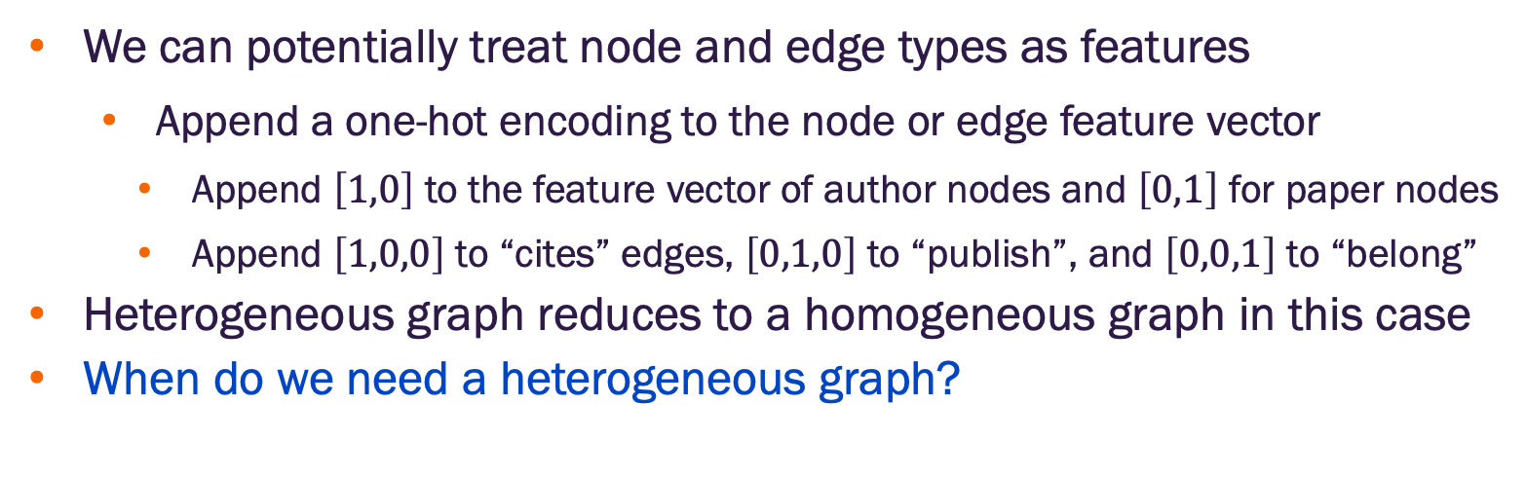
Types as features?
We can potentially treat node and edge types as features
Append a one-hot encoding to the node or edge feature vector
Append $\left[1,0\right]$ to the feature vector of author nodes and $\left[0,1\right]$ for paper nodes
Append $\left[1,0,0\right]$ to “cites” edges, $\left[0,1,0\right]$ to “publish”, and $\left[0,0,1\right]$ to “belong”
Heterogeneous graph reduces to a homogeneous graph in this case
When do we need a heterogeneous graph?

Slide 13
When do we need a heterogeneous graph?
Case 1: Different node / edge types have different feature dimensions
Example: ”Author” nodes have 4 features while ”Paper” nodes have 10 features
Case 2: Different relation types (n,e,n) represent different interaction for which we expect different models are needed
Example: (English, translate, French) requires a different model than (English, translate, Mandarin Chinese)
The tradeoff: a heterogeneous graph is a more expressive representation, but it is also has
increased computation and storage costs relative to homogeneous graphs
more complex implementation

Slide 14
Extending GCNs for heterogeneous graphs

Slide 15
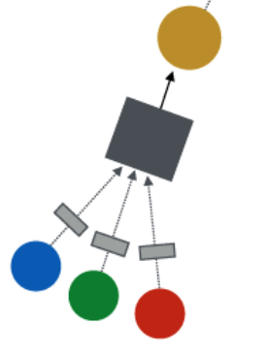
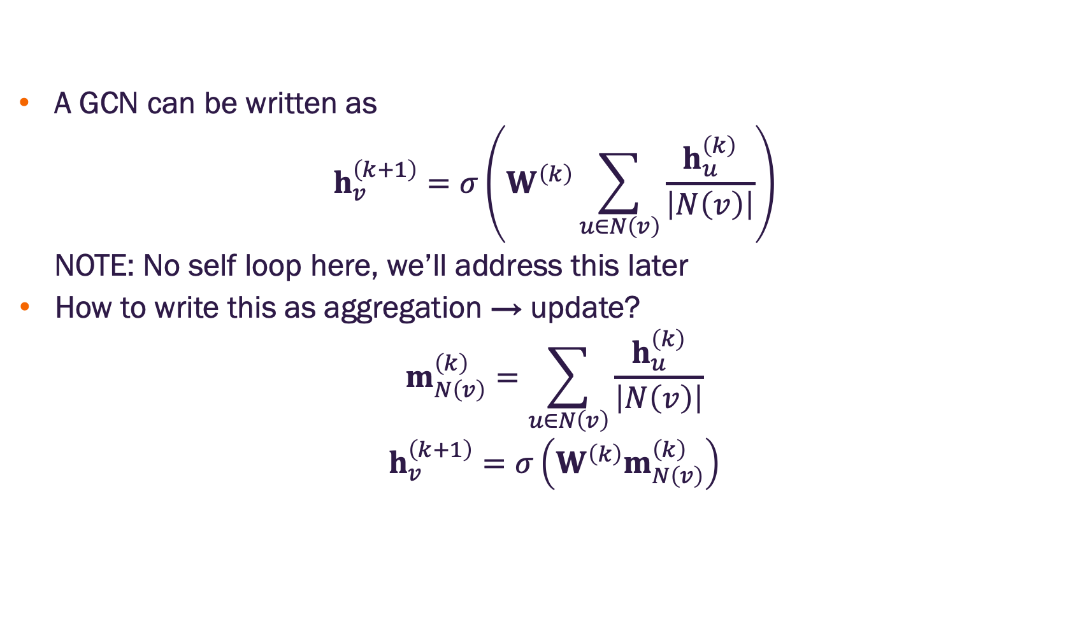
Graph convolutional networks
A GCN can be written as
$$h_{v}^{\left(k+1\right)}=σ\left(W^{\left(k\right)}\sum_{u∈N\left(v\right)}{\frac{h_{u}^{\left(k\right)}}{\left|N\left(v\right)\right|}}\right)$$
NOTE: No self loop here, we’ll address this later
How to write this as aggregation → update?
$$m_{N\left(v\right)}^{\left(k\right)}=\sum_{u∈N\left(v\right)}{\frac{h_{u}^{\left(k\right)}}{\left|N\left(v\right)\right|}}$$
$$h_{v}^{\left(k+1\right)}=σ\left(W^{\left(k\right)}m_{N\left(v\right)}^{\left(k\right)}\right)$$
Updated message
Aggregation
Messages

Slide 16
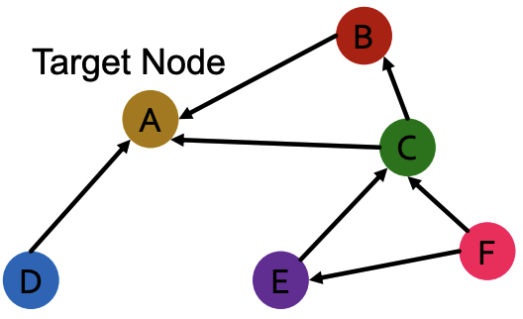
Relational graph convolutional networks (RGCN)
Extend GCN to handle heterogeneous graphs with multiple relation types
Start with a directed graph with one relation
How do we run GCN and update the representation of target node A on this graph?
Image credit: Jure Leskovec, http://cs224w.stanford.edu

Slide 17
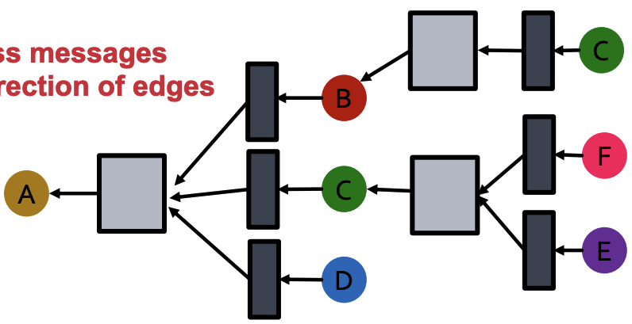
Relational graph convolutional networks (RGCN)
Extend GCN to handle heterogeneous graphs with multiple relation types
Start with a directed graph with one relation
How do we run GCN and update the representation of target node A on this graph?
This is implemented via the appropriate adjacency matrix
Only pass messages along the edge directions
Same neural network across all aggregations
Image credit: Jure Leskovec, http://cs224w.stanford.edu

Slide 18
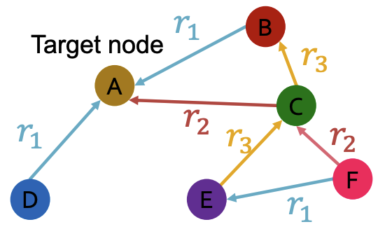
Relational graph convolutional networks (RGCN)
What if the graph has multiple relation types?
Image credit: Jure Leskovec, http://cs224w.stanford.edu

Slide 19
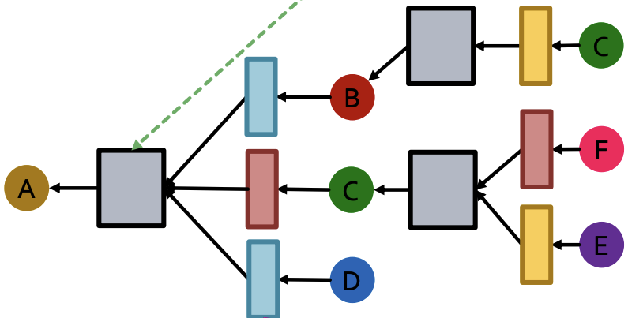
Relational graph convolutional networks (RGCN)
What if the graph has multiple relation types?
Use different neural networks for different relation types
Aggregation
Distinct neural network for each relation type
Image credit: Jure Leskovec, http://cs224w.stanford.edu

Slide 20
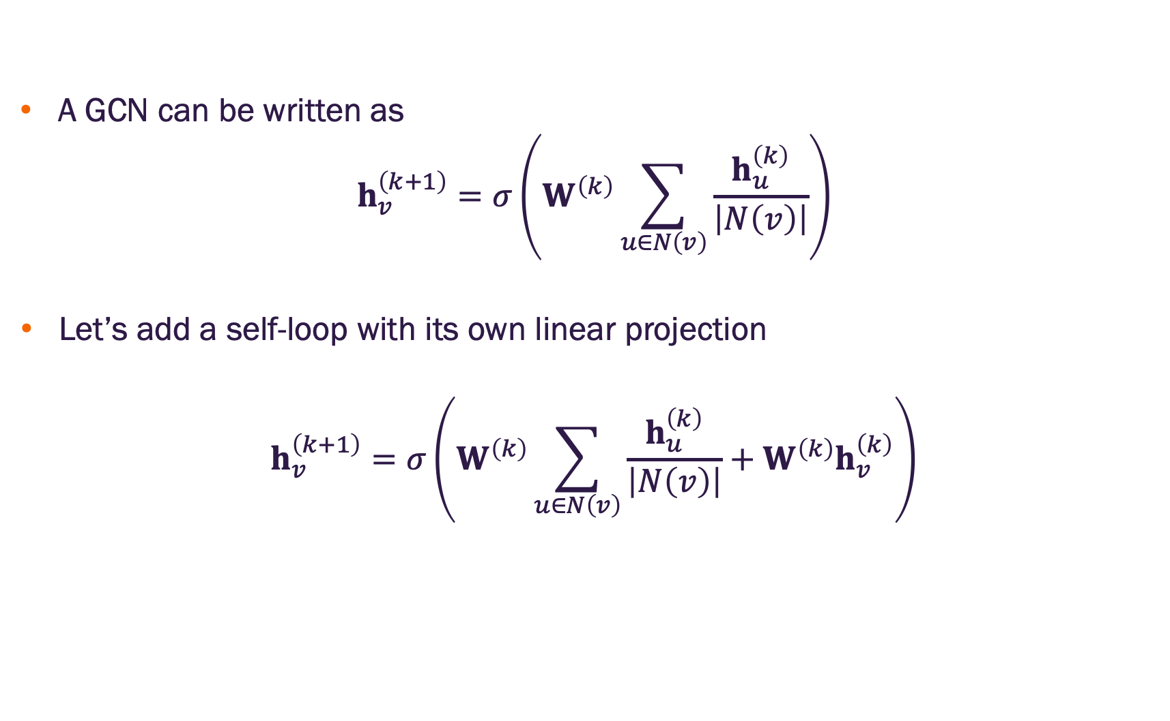
Graph convolutional networks with self-loop matrix
A GCN can be written as
$$h_{v}^{\left(k+1\right)}=σ\left(W^{\left(k\right)}\sum_{u∈N\left(v\right)}{\frac{h_{u}^{\left(k\right)}}{\left|N\left(v\right)\right|}}\right)$$
Let’s add a self-loop with its own linear projection
$$h_{v}^{\left(k+1\right)}=σ\left(W^{\left(k\right)}\sum_{u∈N\left(v\right)}{\frac{h_{u}^{\left(k\right)}}{\left|N\left(v\right)\right|}}+W^{\left(k\right)}h_{v}^{\left(k\right)}\right)$$

Slide 21
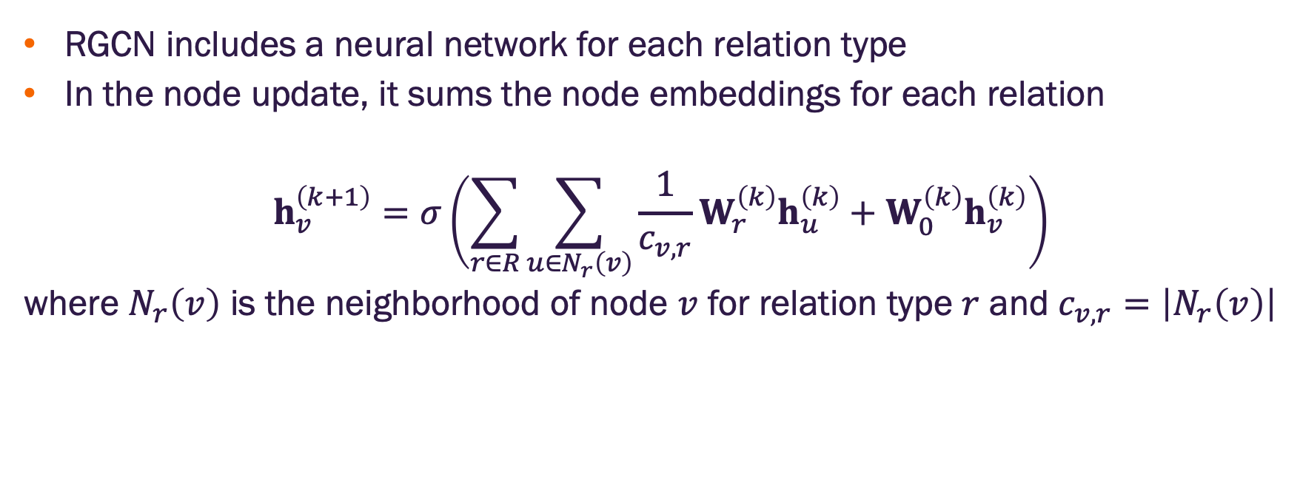
Relational graph convolutional networks (RGCN)
RGCN includes a neural network for each relation type
In the node update, it sums the node embeddings for each relation
$$h_{v}^{\left(k+1\right)}=σ\left(\sum_{r∈R}{\sum_{u∈N_{r}\left(v\right)}{\frac{1}{c_{v,r}}W_{r}^{\left(k\right)}h_{u}^{\left(k\right)}}}+W_{0}^{\left(k\right)}h_{v}^{\left(k\right)}\right)$$
where $N_{r}\left(v\right)$ is the neighborhood of node $v$ for relation type $r$ and $c_{v,r}=\left|N_{r}\left(v\right)\right|$

Slide 22
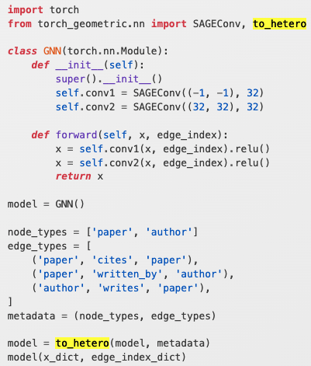
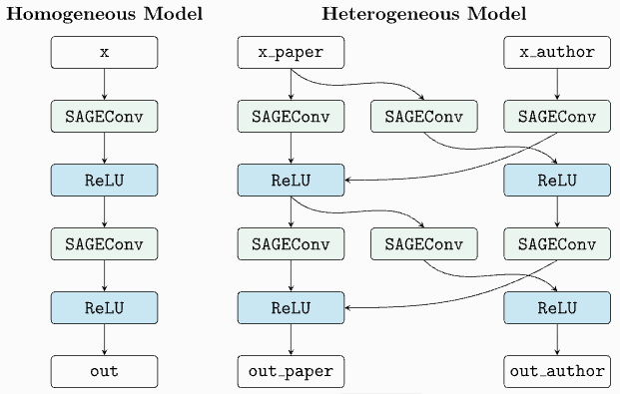
RGCN PyG implementation
The PyG to_hetero method converts a homogeneous GNN model into its heterogeneous equivalent
x_dict and edge_index_dict are dictionaries that hold node feature and edge connection information for each node and edge type, respectively

Slide 23
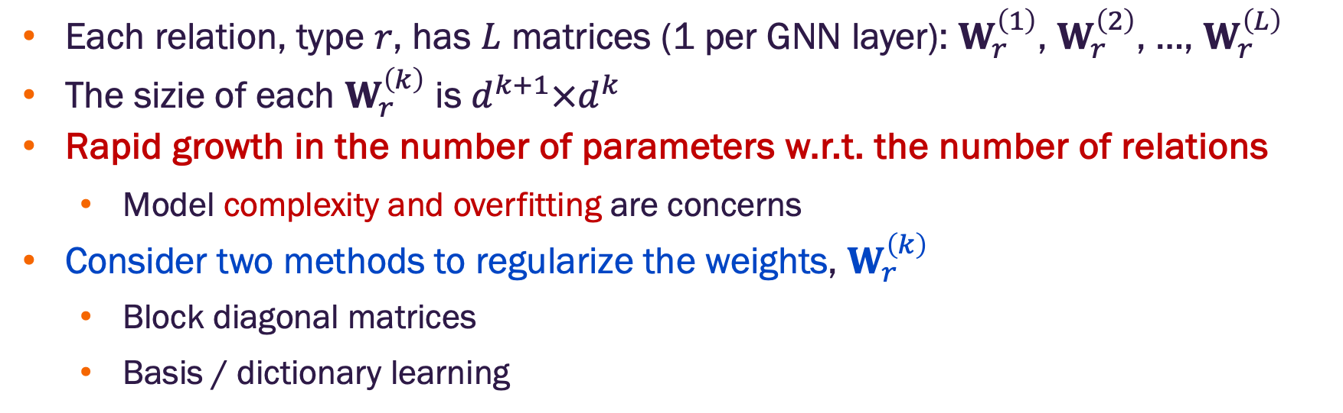
RGCN parameter growth
Each relation, type $r$, has $L$ matrices (1 per GNN layer): $W_{r}^{\left(1\right)}$, $W_{r}^{\left(2\right)}$, …, $W_{r}^{\left(L\right)}$
The sizie of each $W_{r}^{\left(k\right)}$ is $d^{k+1}×d^{k}$
Rapid growth in the number of parameters w.r.t. the number of relations
Model complexity and overfitting are concerns
Consider two methods to regularize the weights, $W_{r}^{\left(k\right)}$
Block diagonal matrices
Basis / dictionary learning

Slide 24
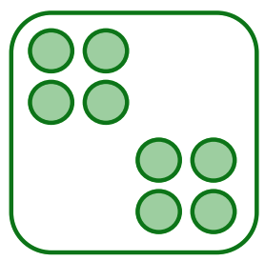
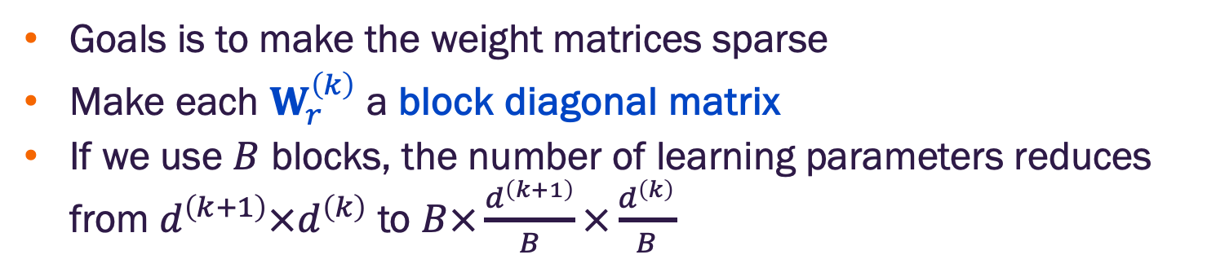
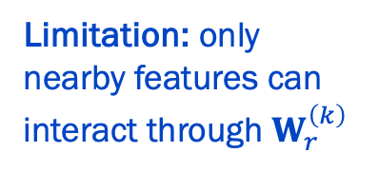
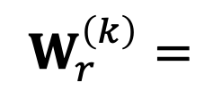
RGCN with block diagonal weight matrices
Goals is to make the weight matrices sparse
Make each $W_{r}^{\left(k\right)}$ a block diagonal matrix
If we use $B$ blocks, the number of learning parameters reduces from $d^{\left(k+1\right)}×d^{\left(k\right)}$ to $B×\frac{d^{\left(k+1\right)}}{B}×\frac{d^{\left(k\right)}}{B}$
$$W_{r}^{\left(k\right)}=$$
Limitation: only nearby features can interact through $W_{r}^{\left(k\right)}$

Slide 25
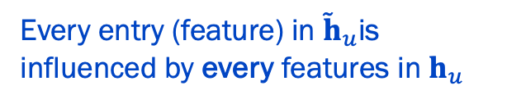
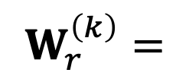
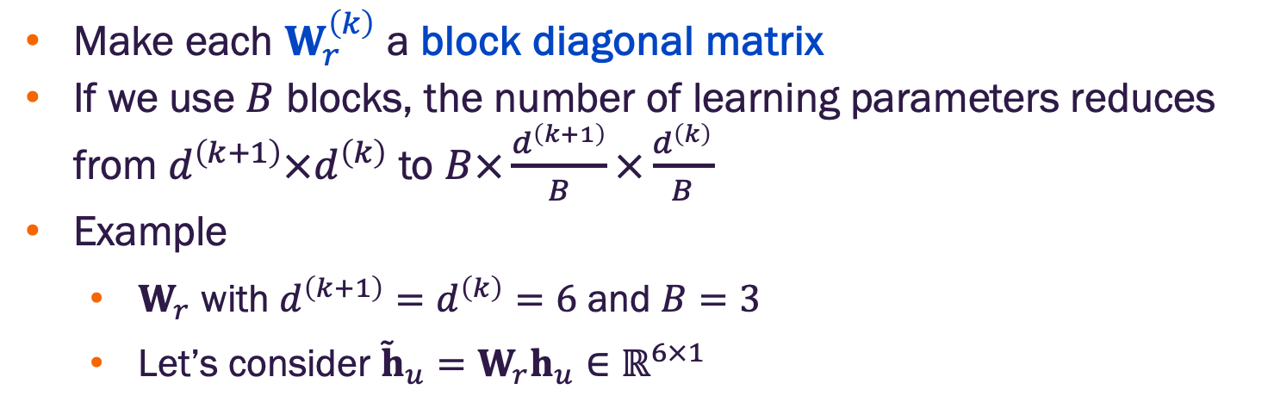
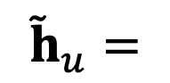
RGCN with block diagonal weight matrices
Make each $W_{r}^{\left(k\right)}$ a block diagonal matrix
If we use $B$ blocks, the number of learning parameters reduces from $d^{\left(k+1\right)}×d^{\left(k\right)}$ to $B×\frac{d^{\left(k+1\right)}}{B}×\frac{d^{\left(k\right)}}{B}$
Example
$W_{r}$ with $d^{\left(k+1\right)}=d^{\left(k\right)}=6$ and $B=3$
Let’s consider ${\tilde{h}}_{u}=W_{r}h_{u}∈ℝ^{6×1}$
Every entry (feature) in ${\tilde{h}}_{u}$is influenced by every features in $h_{u}$
w₁₁ w₁₂ w₁₃ w₁₄ w₁₅ w₁₆
w₂₁ w₂₂ w₂₃ w₂₄ w₂₅ w₂₆
w₃₁ w₃₂ w₃₃ w₃₄ w₃₅ w₃₆
w₄₁ w₄₂ w₄₃ w₄₄ w₄₅ w₄₆
w₅₁ w₅₂ w₅₃ w₅₄ w₅₅ w₅₆
w₆₁ w₆₂ w₆₃ w₆₄ w₆₅ w₆₆
w₁₁$h_{u,1}$ + w₁₂ $h_{u,2}$ + w₁₃ $h_{u,3}$ + w₁₄ $h_{u,4}+$ w₁₅ $h_{u,5}+$ w₁₆ $h_{u,6}$
$$W_{r}^{\left(k\right)}=$$
$${\tilde{h}}_{u}=$$
w₆₁ $h_{u,1}$ + w₆₂ $h_{u,2}$ + w₆₃ ₁₃ $h_{u,3}$ + w₆₄ w₁₄ $h_{u,4}$ w₆₅ $h_{u,5}+$ w₆₆ $h_{u,6}$
Standard approach requires $d^{\left(k+1\right)}×d^{\left(k\right)}=36$ learning parameters

Slide 26
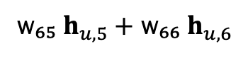
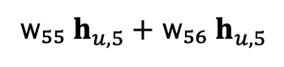
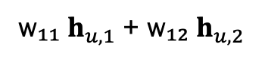
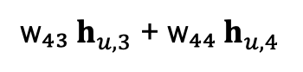
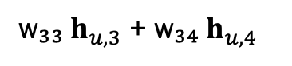
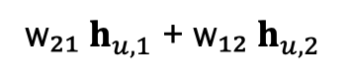
RGCN with block diagonal weight matrices
Make each $W_{r}^{\left(k\right)}$ a block diagonal matrix
If we use $B$ blocks, the number of learning parameters reduces from $d^{\left(k+1\right)}×d^{\left(k\right)}$ to $B×\frac{d^{\left(k+1\right)}}{B}×\frac{d^{\left(k\right)}}{B}$
Example
$W_{r}$ with $d^{\left(k+1\right)}=d^{\left(k\right)}=6$ and $B=3$
Let’s consider ${\tilde{h}}_{u}=W_{r}h_{u}∈ℝ^{6×1}$
Each feature is a transformation of a subset of the overall features (similar to a factor analysis)
w₁₁ w₁₂ 0 0 0 0
w₂₁ w₂₂ 0 0 0 0
0 0 w₃₃ w₃₄ 0 0
0 0 w₄₃ w₄₄ 0 0
0 0 0 0 w₅₅ w₅₆
0 0 0 0 w₆₅ w₆₆
w₁₁ $h_{u,1}$ + w₁₂ $h_{u,2}$
w₂₁ $h_{u,1}$ + w₁₂ $h_{u,2}$
$$W_{r}^{\left(k\right)}=$$
w₃₃ $h_{u,3}$ + w₃₄ $h_{u,4}$
$${\tilde{h}}_{u}=$$
w₄₃ $h_{u,3}$ + w₄₄ $h_{u,4}$
w₅₅ $h_{u,5}+$ w₅₆ $h_{u,5}$
w₆₅ $h_{u,5}+$ w₆₆ $h_{u,6}$
Standard approach requires $B×\frac{d^{\left(k+1\right)}}{B}×\frac{d^{\left(k\right)}}{B}=12$ learning parameters
Notes:
This constraint can actually be viewed as a form of feature grouping or factorization - you're implicitly assuming that the feature space can be partitioned into groups that should be processed somewhat independently.

Slide 27
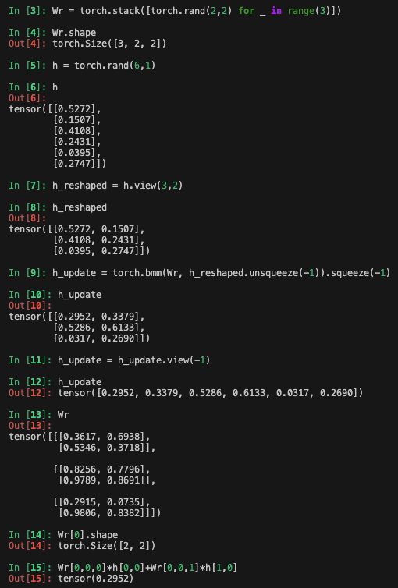
RGCN with block diagonal weight matrices
Not currently implemented in PyG
Implementation: do not create a sparse matrix
Create the blocks and use batch matrix multiply
In PyTorch / PyG the parameters would be created with nn.Parameter (see link below)
# Stack blocks into shape (B, block_size, block_size)
W_r_blocks = torch.stack([block_1, block_2, block_3])
# Reshape h_u from (6,) to (B, block_size)
h_u_reshaped = h_u.view(3, 2) # Shape: (3, 2)
# Batched matrix-vector multiply
output = torch.bmm(W_r_blocks, h_u_reshaped.unsqueeze(-1)).squeeze(-1)
# Flatten back to (6,)
output = output.view(-1)
https://github.com/masino-teaching/ml4g/blob/main/notebooks/RGCN-with-block-diagonal-weights.ipynb
Notes:
This constraint can actually be viewed as a form of feature grouping or factorization - you're implicitly assuming that the feature space can be partitioned into groups that should be processed somewhat independently.

Slide 28
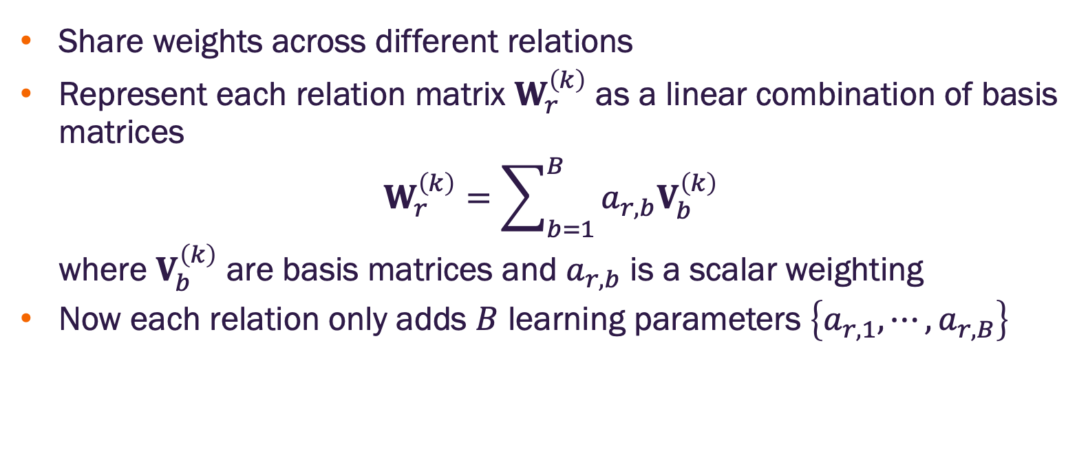
RCGN with basis learning
Share weights across different relations
Represent each relation matrix $W_{r}^{\left(k\right)}$ as a linear combination of basis matrices
$$W_{r}^{\left(k\right)}=\sum_{b=1}^{B}{a_{r,b}V_{b}^{\left(k\right)}}$$
where $V_{b}^{\left(k\right)}$ are basis matrices and $a_{r,b}$ is a scalar weighting
Now each relation only adds $B$ learning parameters $\left\{a_{r,1},⋯,a_{r,B}\right\}$

Slide 29
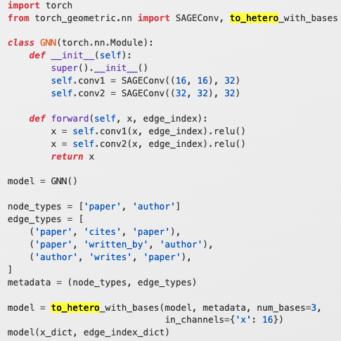
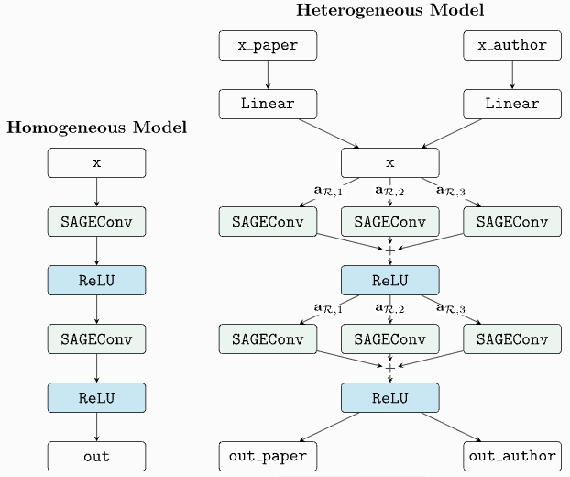
RGCN PyG implementation
The PyG to hetero with bases method converts a homogeneous GNN model into its heterogeneous equivalent
x_dict and edge_index_dict are dictionaries that hold node feature and edge connection information for each node and edge type, respectively

Slide 30
Inferences on relational graphs

Slide 31
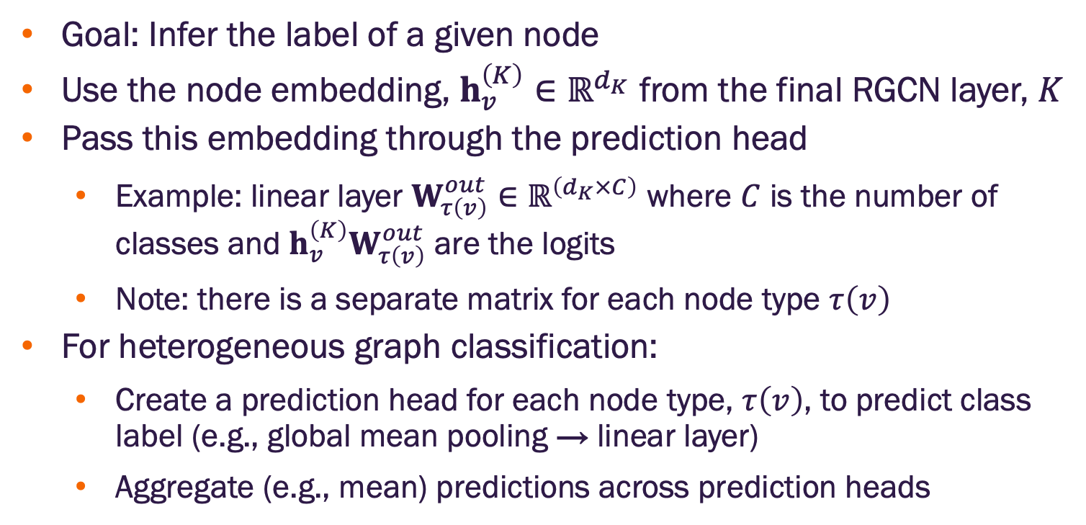
Heterogeneous graph / node classification
Goal: Infer the label of a given node
Use the node embedding, $h_{v}^{\left(K\right)}∈ℝ^{d_{K}}$ from the final RGCN layer, $K$
Pass this embedding through the prediction head
Example: linear layer $W_{τ\left(v\right)}^{out}∈ℝ^{\left(d_{K}×C\right)}$ where $C$ is the number of classes and $h_{v}^{\left(K\right)}W_{τ\left(v\right)}^{out}$ are the logits
Note: there is a separate matrix for each node type $τ\left(v\right)$
For heterogeneous graph classification:
Create a prediction head for each node type, $τ\left(v\right)$, to predict class label (e.g., global mean pooling → linear layer)
Aggregate (e.g., mean) predictions across prediction heads

Slide 32
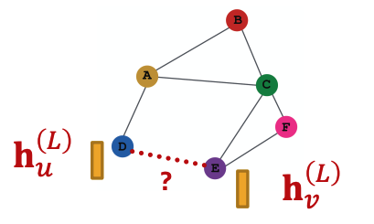
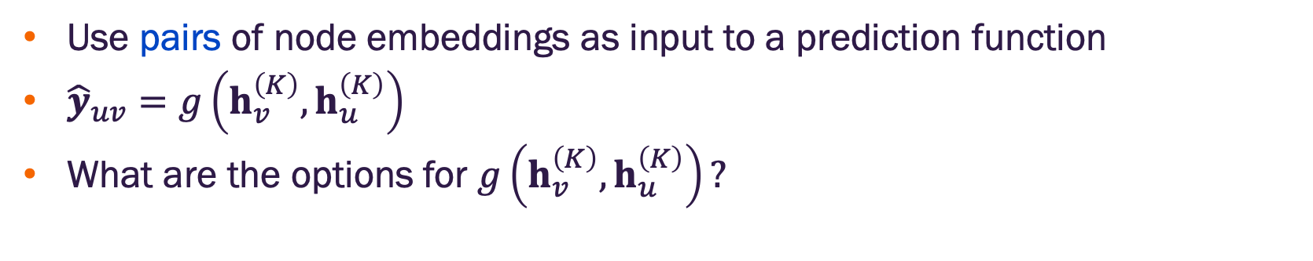
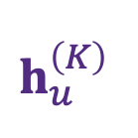
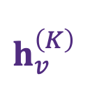
Edge-level prediction head
Use pairs of node embeddings as input to a prediction function
${\hat{y}}_{uv}=g\left(h_{v}^{\left(K\right)},h_{u}^{\left(K\right)}\right)$
What are the options for $g\left(h_{v}^{\left(K\right)},h_{u}^{\left(K\right)}\right)?$
$$h_{v}^{\left(K\right)}$$
$$h_{u}^{\left(K\right)}$$
Image credit: Jure Leskovec, http://cs224w.stanford.edu

Slide 33
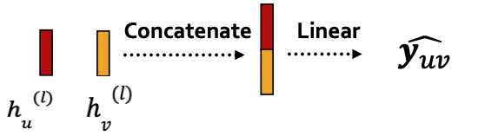
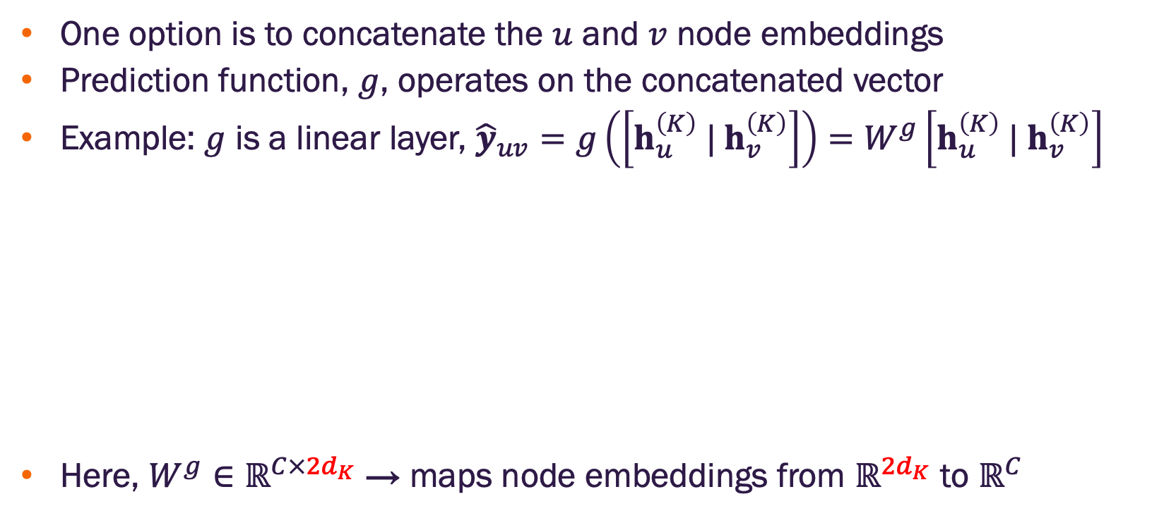

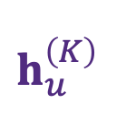
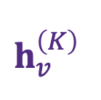
Edge-level prediction head with concatenation
One option is to concatenate the $u$ and $v$ node embeddings
Prediction function, $g$, operates on the concatenated vector
Example: $g$ is a linear layer, ${\hat{y}}_{uv}=g\left(\left[h_{u}^{\left(K\right)} |{ h}_{v}^{\left(K\right)}\right]\right)=W^{g}\left[h_{u}^{\left(K\right)} |{ h}_{v}^{\left(K\right)}\right]$
Here, $W^{g}∈ℝ^{C×{2d}_{K}}$ → maps node embeddings from $ℝ^{{2d}_{K}}$ to $ℝ^{C}$
$${\hat{y}}_{uv}$$
$$h_{v}^{\left(K\right)}$$
$$h_{u}^{\left(K\right)}$$
Account for the concatenation of embeddings
Image credit: Jure Leskovec, http://cs224w.stanford.edu

Slide 34
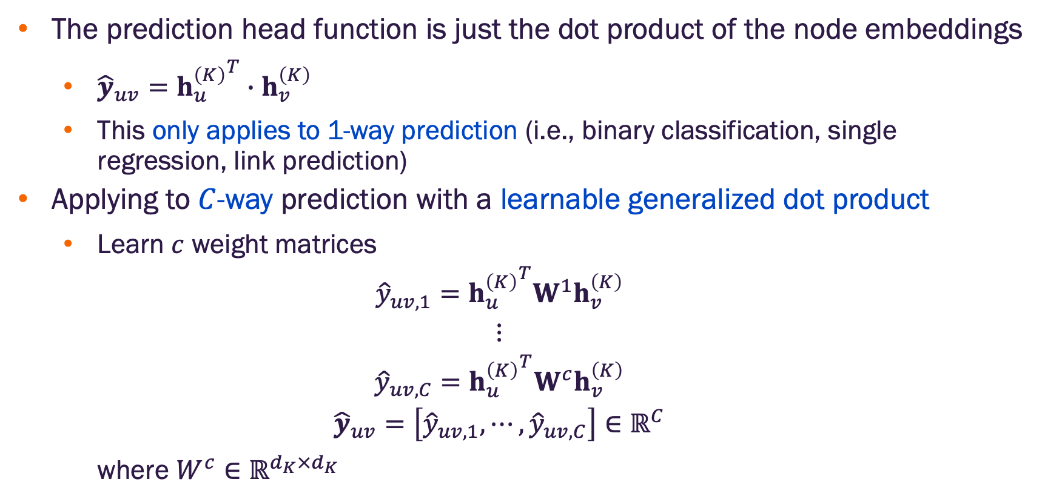
Edge-level prediction head with dot product
The prediction head function is just the dot product of the node embeddings
${\hat{y}}_{uv}={h_{u}^{\left(K\right)}}^{T}∙h_{v}^{\left(K\right)}$
This only applies to 1-way prediction (i.e., binary classification, single regression, link prediction)
Applying to $C$-way prediction with a learnable generalized dot product
Learn $c$ weight matrices
$${\hat{y}}_{uv,1}={h_{u}^{\left(K\right)}}^{T}W^{1}h_{v}^{\left(K\right)}$$
$$⋮$$
$${\hat{y}}_{uv,C}={h_{u}^{\left(K\right)}}^{T}W^{c}h_{v}^{\left(K\right)}$$
$${\hat{y}}_{uv}=\left[{\hat{y}}_{uv,1},⋯,{\hat{y}}_{uv,C}\right]∈ℝ^{C}$$
where $W^{c}∈ℝ^{d_{K}×d_{K}}$

Slide 35
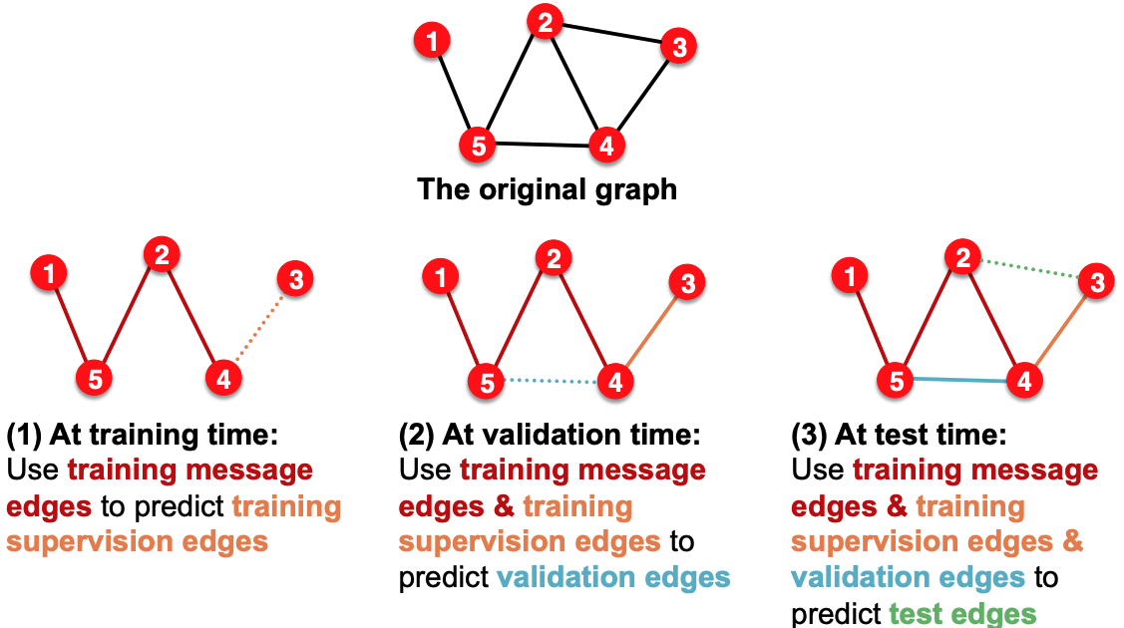
Setting up edge prediction
Transductive link prediction split
Image credit: Jure Leskovec, http://cs224w.stanford.edu

Slide 36
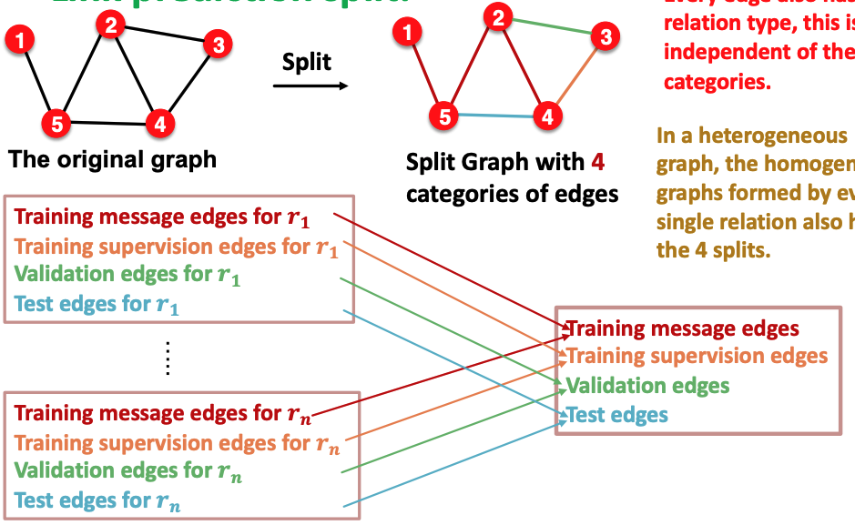
Setting up edge prediction
Edge prediction split
Every edge has a relation type, independent of the four (4) categories of splits
For a heterogeneous graph, the homogeneous graphs formed by a given relation, has four (4) splits
Image credit: Jure Leskovec, http://cs224w.stanford.edu

Slide 37


RGCN for edge prediction
Assume (E, r₃, A) is a training supervision edge, and all other edges are training message edges
Other edges (not shown yet) are validation or test supervision edges
Use the RGCN to predict probability for edge (E, r₃, A)
Take the final RGCN layer embeddings, $h_{E}^{\left(K\right)}$ and $h_{A}^{\left(K\right)}$ , for E and A
Apply a relation specific prediction head $g_{r}:$ $ℝ^{d_{K}×d_{K}}→ℝ$
Example: $g_{r_{3}}={\left(h_{E}^{\left(K\right)}\right)}^{T}W_{r_{3}}h_{A}^{\left(K\right)}$ where $W_{r_{3}}∈ℝ^{d_{K}×d_{K}}$
Image credit: Jure Leskovec, http://cs224w.stanford.edu

Slide 38
RGCN training for edge prediction
Use the RCGN to score the training supervision edge (E, r₃, A)
Message passing occurs only on the training message edges for this relation type
Create negative edge(s) by perturbing the supervision edge (E, r₃, A), for example by changing the tail: (E, r₃, B), (E, r₃, F)
Negative edges should not be in the actual graph (i.e., not a member of any of the 4 splits)
Image credit: Jure Leskovec, http://cs224w.stanford.edu

Slide 39

RGCN training for edge prediction
Use the RCGN to score the training supervision edge (E, r₃, A)
Message passing occurs only on the training message edges for this relation type
Create negative edge(s) by perturbing the supervision edge (E, r₃, A), for example by changing the tail: (E, r₃, B), (E, r₃, F)
Negative edges should not be in the actual graph (i.e., not a member of any of the 4 splits)
Score the negative edge with the RCGN
Optimize cross-entropy loss function
$$l=−logσ\left(g_{r_{3}}\left(h_{E}^{\left(K\right)},h_{A}^{\left(K\right)}\right)\right)−log⁡\left(1−σ\left(g_{r_{3}}\left(h_{E}^{\left(K\right)},h_{B}^{\left(K\right)}\right)\right)\right)$$
Image credit: Jure Leskovec, http://cs224w.stanford.edu

Slide 40

RGCN evaluation for edge prediction
How should we evaluate model performance?
We could use standard binary classification performance metrics, but these do not align with the typical use case
Most applications involve very large, sparse graphs
Nearly all “edge” predictions are negative
The typical requirement is ”precision”, more specifically, if the model indicates there are $K$ predicted edges that are “missing” from the graph, how many of these are valid?
Intuition: we want the score for validation / test supervision edges to be greater than negative samples, without worrying about the normalized probability
Image credit: Jure Leskovec, http://cs224w.stanford.edu

Slide 41

RGCN evaluation for edge prediction
Consider evaluation during validation (same procedure for test)
Assume (E, r₃, D) is a validation supervision edge
Use the RCGN to score (E, r₃, D) and sampled negative edges, let’s assume those are (E, r₃, B), (E, r₃, F)
Rank the edges by their RCGN score
Obtain the rank, $R_{K}$, of the (E, r₃, D), where $K$ is the number of edges considered
Repeat this for all validation edges
Compute Hits@k – that is, how many of the validation supervision edges have a rank of $k<K$ or better? (Higher number of “hits” is better)
Reciprocal rank $\frac{1}{R_{K}}$ (Higher is better – indicates lower $R_{K}$)
Image credit: Jure Leskovec, http://cs224w.stanford.edu

Slide 42


RGCN evaluation for edge prediction
Consider evaluation during validation (same procedure for test)
Assume (E, r₃, D) is a validation supervision edge
Use the RCGN to score (E, r₃, D) and sampled negative edges, let’s assume those are (E, r₃, B), (E, r₃, F)
Here $K=3$ Let’s consider Hits@2 (i.e, $k=2$)
Assume we get following ordering
$g_{r_{3}}\text{(}\text{E}\text{, }\text{r}\text{3}\text{, }\text{D}\text{)}$
$g_{r_{3}}\text{(}\text{E}\text{, }\text{r}\text{3}\text{,} \text{B}\text{)}$
$g_{r_{3}}\text{(}\text{E}\text{, }\text{r}\text{3}\text{,} \text{F}\text{)}$
$R_{K}$ of is 1 (E, r₃, D)
Increment hits@2 by 1
Reciprocal rank is 1 for this sample
Image credit: Jure Leskovec, http://cs224w.stanford.edu

Slide 43


RGCN evaluation for edge prediction
Consider evaluation during validation (same procedure for test)
Assume (E, r₃, D) is a validation supervision edge
Use the RCGN to score (E, r₃, D) and sampled negative edges, let’s assume those are (E, r₃, B), (E, r₃, F)
Here $K=3$ Let’s consider Hits@2 (i.e, $k=2$)
Assume we get following ordering
$g_{r_{3}}\text{(}\text{E}\text{, }\text{r}\text{3}\text{,} \text{B}\text{)}$
$g_{r_{3}}\text{(}\text{E}\text{, }\text{r}\text{3}\text{, }\text{D}\text{)}$
$g_{r_{3}}\text{(}\text{E}\text{, }\text{r}\text{3}\text{,} \text{F}\text{)}$
$R_{K}$ of is 2 (E, r₃, D)
Increment hits@2 by 1
Reciprocal rank is 1/2 for this sample
Image credit: Jure Leskovec, http://cs224w.stanford.edu

Slide 44


RGCN evaluation for edge prediction
Consider evaluation during validation (same procedure for test)
Assume (E, r₃, D) is a validation supervision edge
Use the RCGN to score (E, r₃, D) and sampled negative edges, let’s assume those are (E, r₃, B), (E, r₃, F)
Here $K=3$ Let’s consider Hits@2 (i.e, $k=2$)
Assume we get following ordering
$g_{r_{3}}\text{(}\text{E}\text{, }\text{r}\text{3}\text{,} \text{B}\text{)}$
$g_{r_{3}}\text{(}\text{E}\text{, }\text{r}\text{3}\text{,} \text{F}\text{)}$
$g_{r_{3}}\text{(}\text{E}\text{, }\text{r}\text{3}\text{, }\text{D}\text{)}$
$R_{K}$ of is 3 (E, r₃, D)
Increment hits@2 by 0 (no credit for this sample)
Reciprocal rank is 1/3 for this sample
Image credit: Jure Leskovec, http://cs224w.stanford.edu

Slide 45

Benchmarking heterogeneous graph methods
Numerous heterogeneous graph datasets in PyG

Slide 46
Summary of RGCN
RGCN extends GCN to heterogeneous graphs
Can perform node / graph classification and link prediction
Ideas can be extended to other RGNN models such as RGraphSAGE, RGIN, RGAT

Slide 47


